Slide 1

2101CS08 Amisha Raje
2101CS39 K Lahari
2101CS53 Nishita Lath
Natural Language Processing
EMOTION CAUSE EXTRACTION USING GRAPHS TO CAPTURE THE FLOW OF THE CONVERSATION

Slide 2
INTRODUCTION
This project focuses on extracting emotion-cause pairs from conversations by leveraging graph-based methods. Using the RECCON dataset, conversations are first segmented into meaningful clauses, which are then annotated as emotion, cause, or neutral clauses. Each clause is represented as a node in a graph, and connections between them are established based on linguistic relationships. The resulting graph is input into an EVOLVE GCN model, which learns to predict emotion-cause pairs by capturing the flow and context of the conversation.

Slide 3
Task 1: Clause Segmentation in Dialog Data
DATASET DETAILS
Objective:
Segment utterances from DailyDialog dataset into meaningful clauses for finer-grained analysis.
Approach:
We used the RECCON dataset, which contains multi-turn conversations annotated with emotion-cause pairs.
Utilized Python with spaCy and regex for text processing.
Loaded English language model (en_core_web_sm) for sentence segmentation.
Further split sentences into clauses using common conjunctions (e.g., and, but, or).
Collection

Slide 4
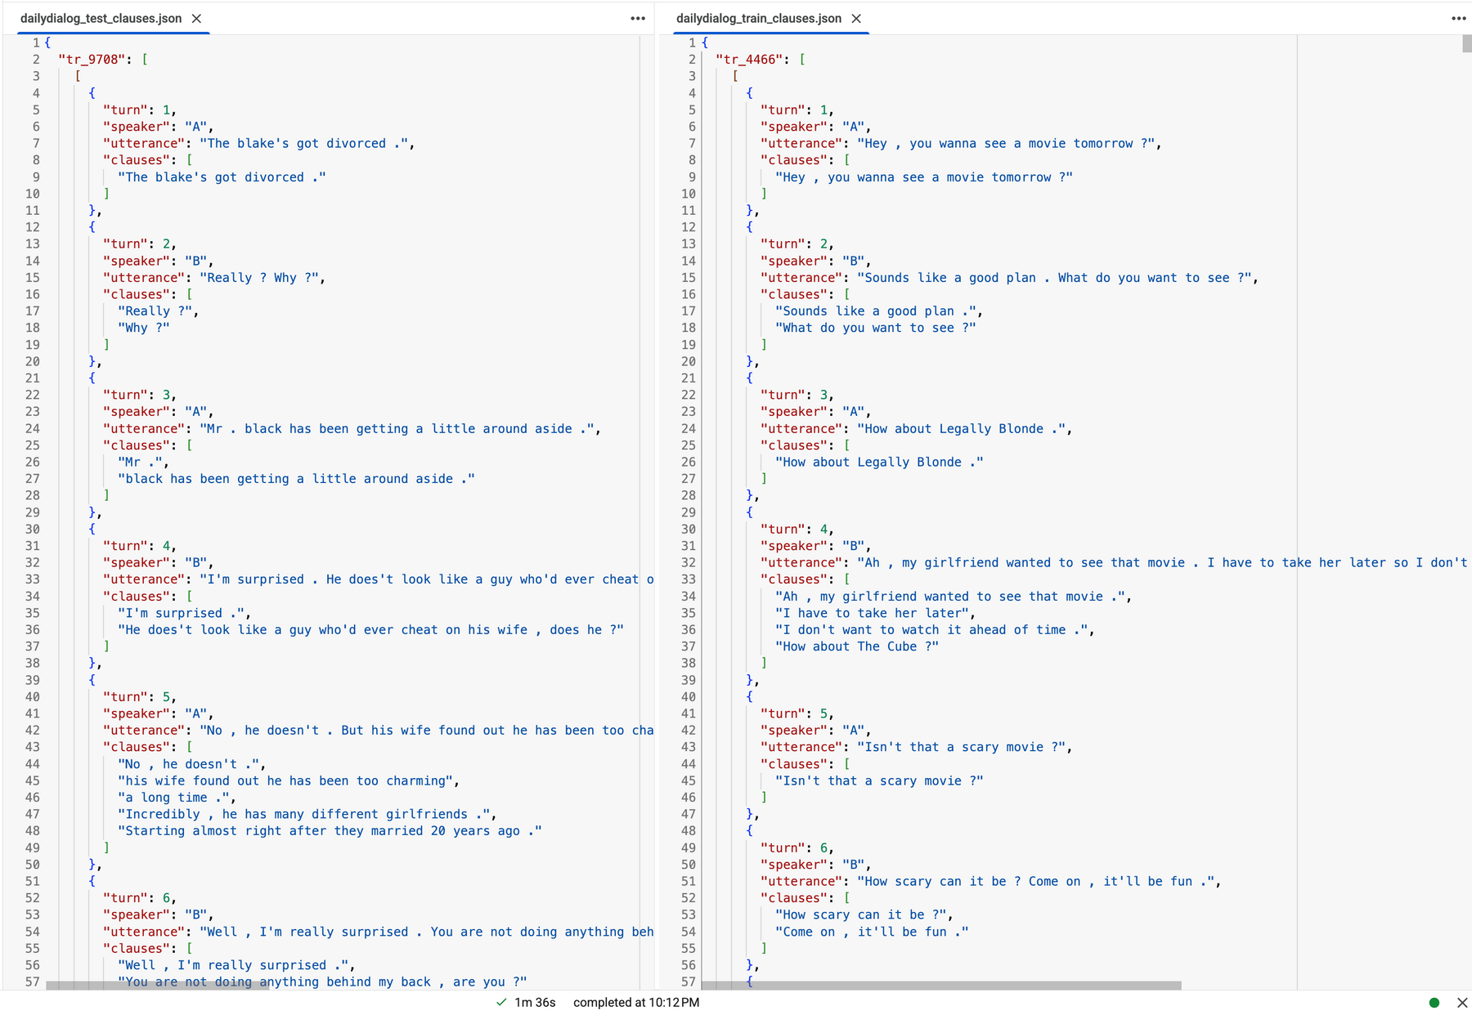
RESULT

Slide 5
Task 2 : Semantic Annotation of Clauses
DATASET DETAILS
Objective:
Automatically label each clause in dialog data as “emotion”, “cause”, or “neither” for deeper dialog understanding.
Approach:
Used Sentence Transformers (all-MiniLM-L6-v2) for semantic similarity.
Defined emotion keywords for quick detection.
Compared clause embeddings with annotated emotion cause spans for cause identification.
Annotation Mechanism

Slide 6
DATASET DETAILS
Annotation Logic:
A clause is labeled as “emotion” if:
It contains emotion keywords, or
It is semantically similar to the utterance and emotion is non-neutral.
A clause is labeled as “cause” if:
Its embedding is similar to any annotated cause span (above a threshold).
Clauses not matching above are labeled “neither”.
Annotation Mechanism

Slide 7
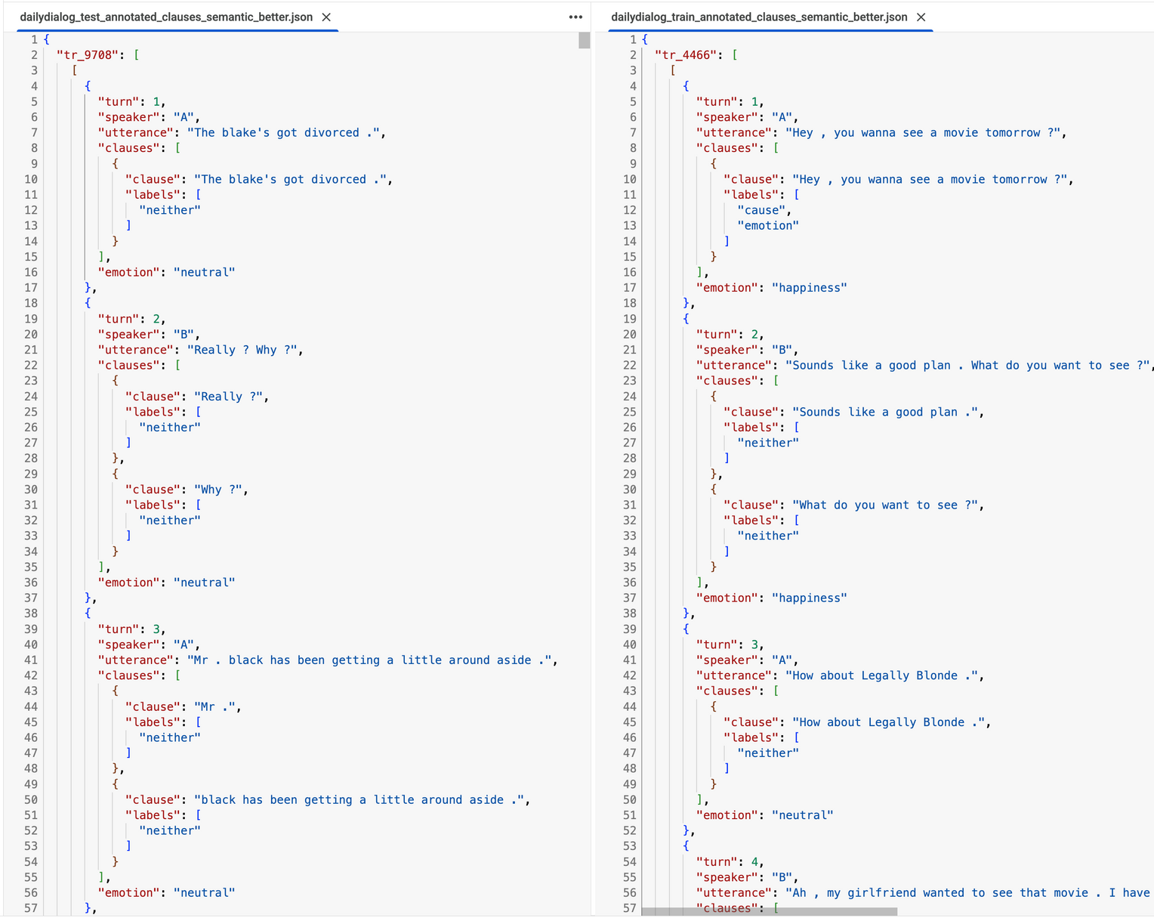
RESULT

Slide 8
Task 3 : Graph Construction & GNN Modeling Dialogs
MODEL
Objective:
Transform annotated dialog data into graph structures and apply Graph Neural Networks (GNNs) for clause-level emotion and cause classification.
Approach:
Each clause in a conversation is a node in the graph.
Node features: Semantic embeddings of clause text (using Sentence Transformers).
Node labels: Encoded as emotion, cause, both, or neither.
Edges:
Sequential edgesbetween consecutive clauses within each utterance.
Self loops for all nodes.
Additional metadata: Utterance index, original text, etc.

Slide 9
MODEL
Implementation:
Used PyTorch Geometric’s Data object to representeach conversation graph.
Saved each graph as a .pt file for downstream deep learning tasks.
Model Training and Evaluation:
Model: Multi-layer GCN (EvolveGCN) for node classification.
Loss: Cross-entropy; Optimizer: Adam
Data split: 80% train, 20% validation.
Training for 20 epochs, with validation accuracy tracked after each epoch.
Automatic GPU/CPU selection for efficient computation.

Slide 10
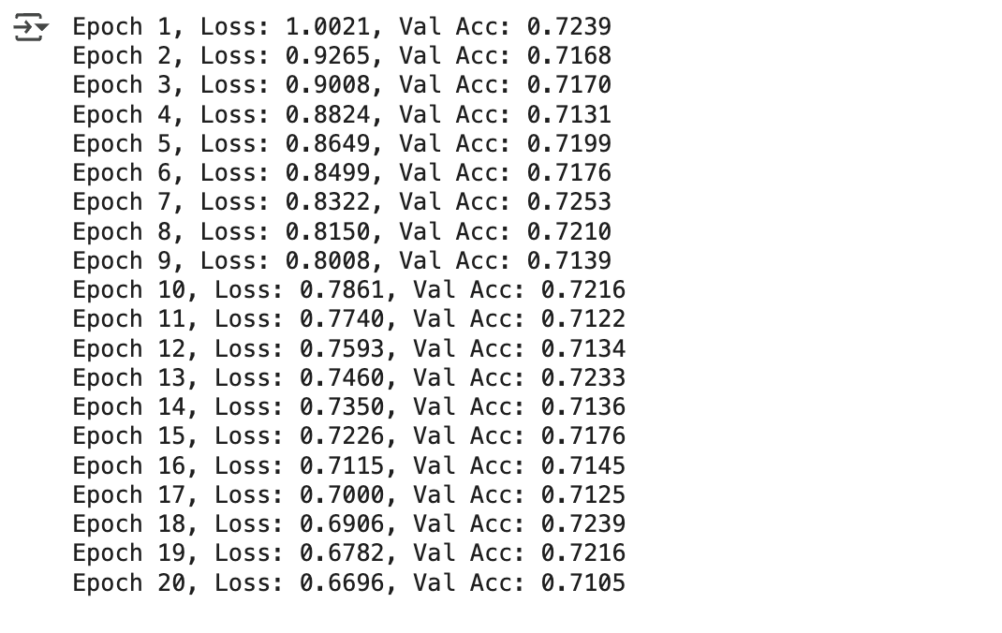
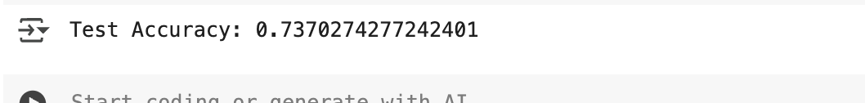
RESULT

Slide 11
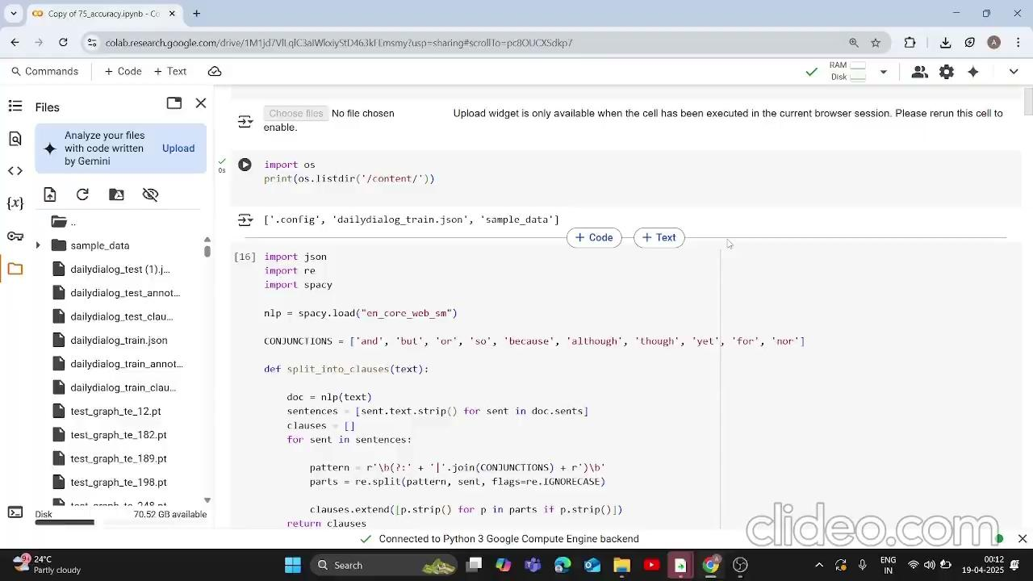
DEMO VIDEO

Slide 12
CONTRIBUTION
I implemented an automated clause segmentation algorithm that breaks down utterances into meaningful clauses using both punctuation marks and a predefined set of conjunctions. This approach significantly reduced the need for manual clause-level annotation, streamlining the data preprocessing and making it more efficient and scalable.To ensure data integrity and avoid information leakage, I performed clause segmentation separately on the training and testing datasets. This allowed for unbiased evaluation in later stages of the pipeline, supporting a reliable assessment of the model's performance across different data splits.
We built a testing pipeline to evaluate model performance using accuracy and detailed classification metrics (precision, recall, F1-score) for each label class. This helped assess how well the model handled multi-class clause classification and highlighted areas for improvement.
Nishita Lath

Slide 13
I developed semantic annotation logic for detecting emotion and cause clauses within segmented utterances. To identify emotion- I used emotion labels from the dataset and a hybrid approach—matching emotion keywords and checking semantic similarity between the clause and original utterance using SentenceTransformer which improved overall accuracy.To identify cause, I compared clause embeddings with known cause spans using cosine similarity. If similarity crossed a threshold, the clause was marked as a cause. Each clause was then labeled as ‘emotion’, ‘cause’, or ‘neither’, with this method applied consistently to both training and testing data.
We built a testing pipeline to evaluate model performance using accuracy and detailed classification metrics (precision, recall, F1-score) for each label class. This helped assess how well the model handled multi-class clause classification and highlighted areas for improvement.
CONTRIBUTION
Amisha Raje

Slide 14
CONTRIBUTION
In this project, I designed and implemented the graph-based data preprocessing pipeline for conversational emotion-cause analysis. For each conversation, I extracted clauses and treated them as nodes, generating rich semantic embeddings using a pre-trained SentenceTransformer model. I constructed edges within each utterance to preserve the sequential flow and added self-loops for enhanced node representation learning. Each node received a multi-class label based on its conversational role—emotion, cause, both, or neither. I serialized these graph structures as PyTorch Geometric Data objects, making them easy to batch and load for model training. I then built and trained an EvolveGCN model on these graphs to perform multi-class clause classification, evaluating performance with standard metrics.
K Lahari

Slide 15
THANK YOU

